Slide 1
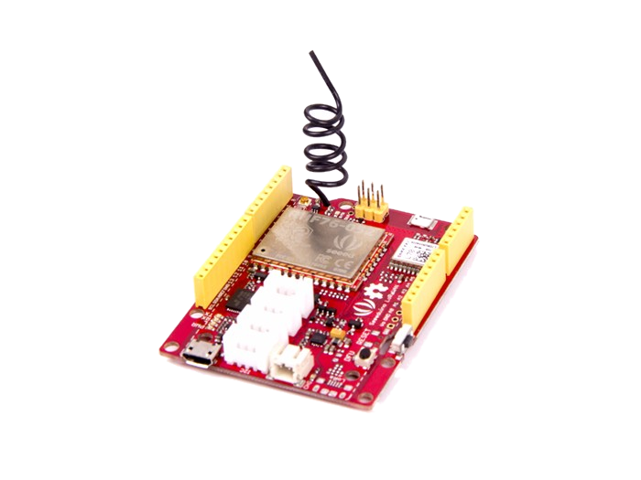
Seeeduino LoRaWAN
Experience LoRa’s advantage
in the field of IoT
Michele La Malva Moreno

Slide 2
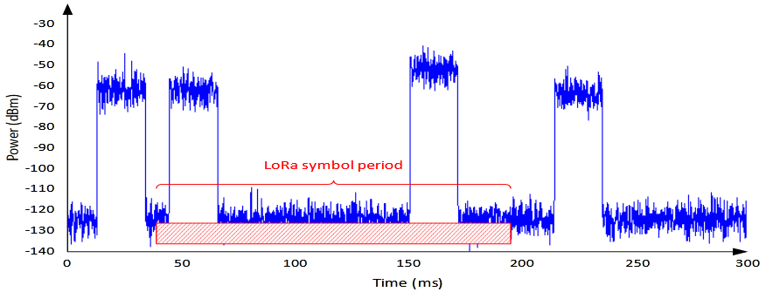
LoRa : Technology
LoRa is the type of radiofrequency modulation patented by Semtech and among its main advantages is:
High tolerance to interference and High sensitivity (-168dB)
Based on FSK modulation
Low consumption
Long range 10 to 20km
Low data transfer (up to 255 bytes)

Slide 3
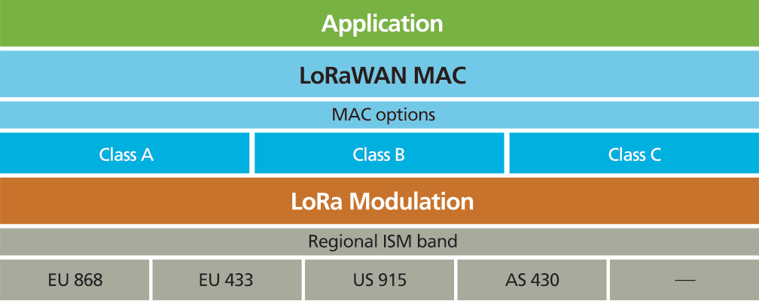
LoRaWAN : Protocol
LoRaWAN is a network protocol that uses LoRa technology to communicate and manage LoRa devices, it consists of two parts mainly: gateways and nodes.
Star topology
AES 128 Encryption
Support 3 Types of nodes
Public and Private networks
Device Management

Slide 4
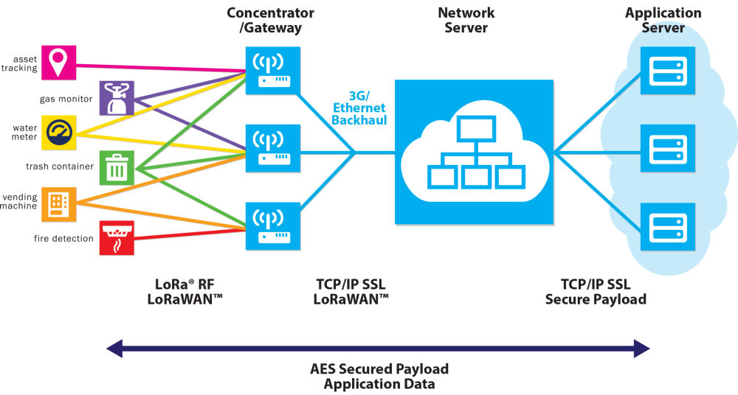
LoRaWAN : Structure

Slide 5
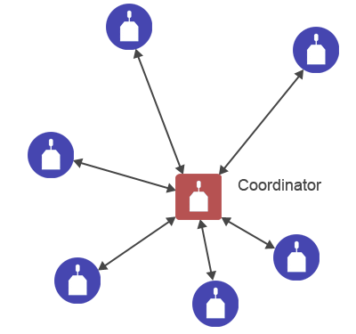
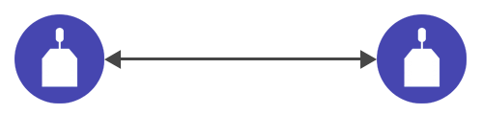
LoRaWAN : LoRa mode
In point-to-point connection (P2P) mode, a gateway device is no needed.
Instead, they can transmit information each others directly.
Point-To-Point connection
Mesh structure connection

Slide 6
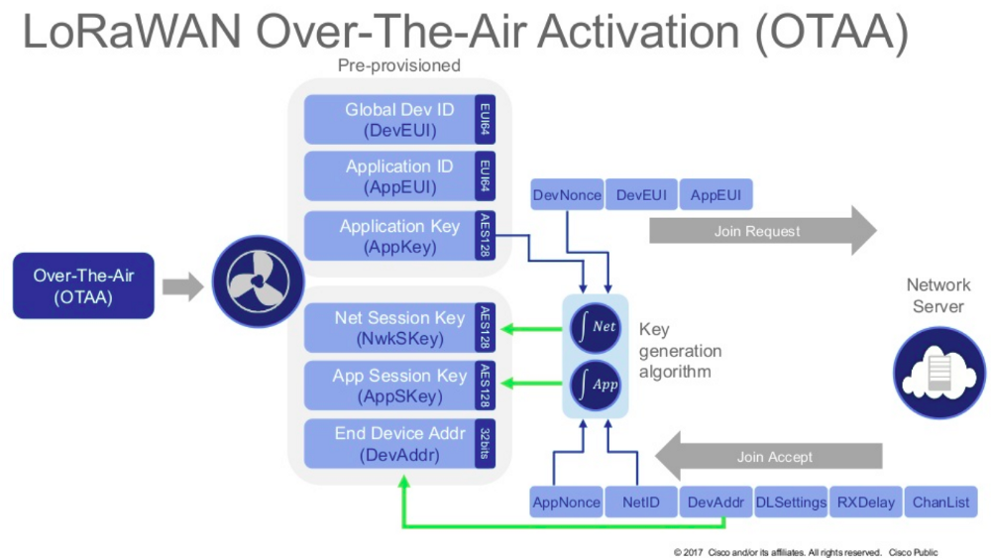
LoRaWAN : LoRaWAN OTAA mode

Slide 7
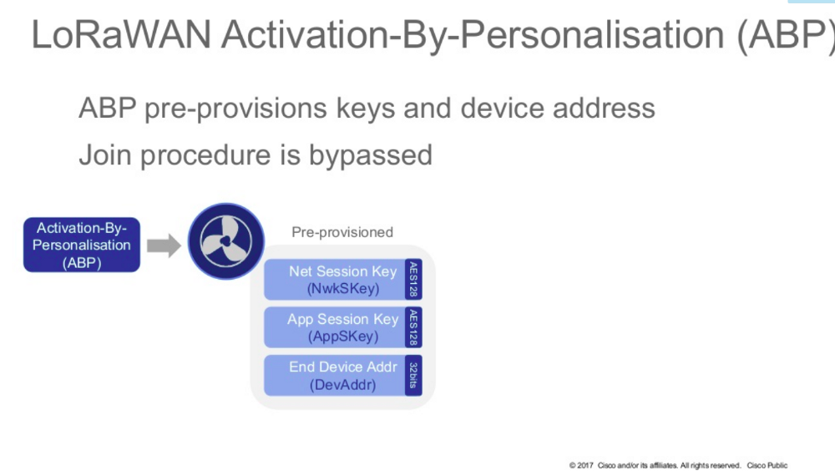
LoRaWAN : LoRaWAN ABP mode

Slide 8
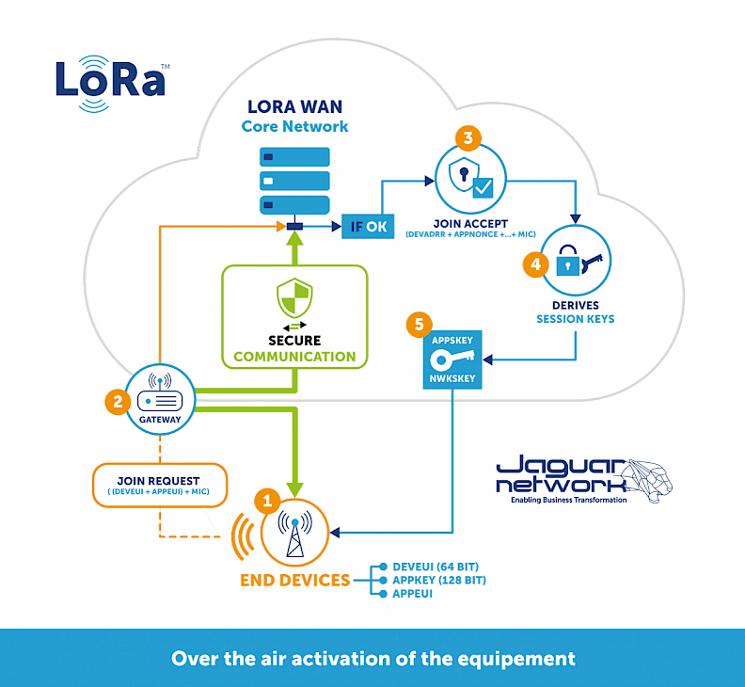
LoRaWAN : LoRaWAN OTAA / ABP mode

Slide 9
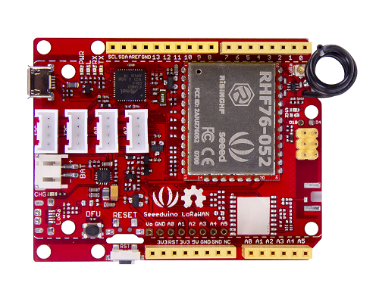
Seeeduino LoRaWAN : Board/Processor
ATSAMD21G18 (32-bit ARM Cortex M0+) @ 48MHz with 3.3V logic/power
Embedded with lithium battery management chip and status indicator led
20 GPIOs (All pins but 2 and 7 are PWM)
1 x analog output (10-bit DAC)
6 x analog inputs (12-bit ADC)
4 on-board Grove connectors
3.3V regulator with 200mA output
Flash Memory : 256 kb
SRAM : 32 kb
Device Firmware Upgrade button
Reset button

Slide 10
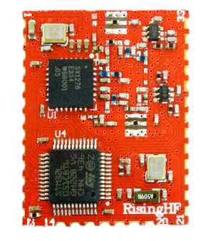
Seeeduino LoRaWAN : Board/Modules
RHF76-052AM LoRaWAN module embedded by SX1276 transceiver and MCU STM32L051/052XX.
High link budget of 160dB. -140dBm sensitivity and 19dBm Output power.
Support Class A/C LoRaWAN protocol
1.45uA sleep current in WOR mode
Dual band:
19dBm@434MHz/470MHz
14dBm@868MHz/915MHz
(Optional) GPS Chip L70B-M39

Slide 11
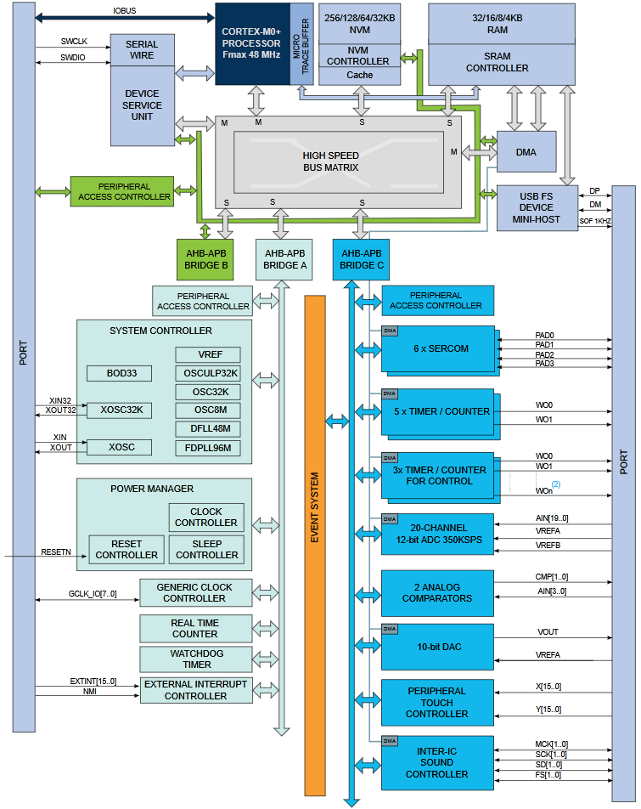
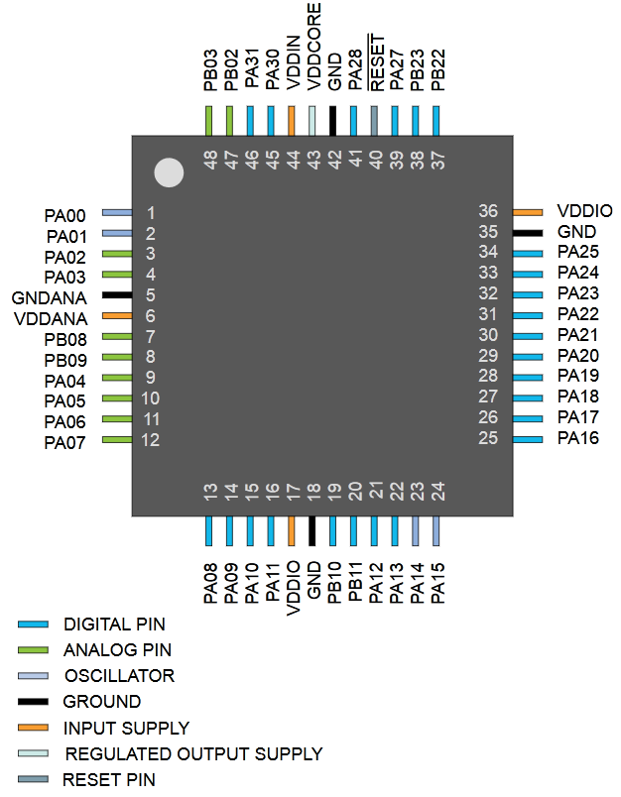
Seeeduino LoRaWAN : Block Diagram

Slide 12
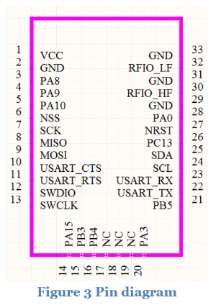
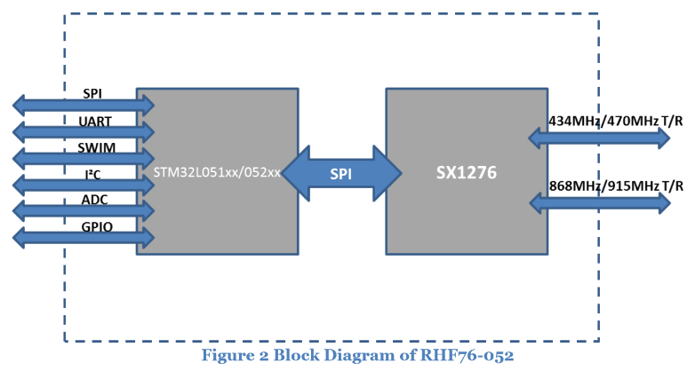
Seeeduino LoRaWAN : Block Diagram

Slide 13
Seeeduino LoRaWAN : In a nutshell
RHF76-52AM module
ATSAMD21G18
Processor
STM32L051/052XX
AT Commands
SPI
SX1276
SRAM, Flash, SERCOM...
Instructions
Gateways, LoRa Devices, etc..

Slide 14
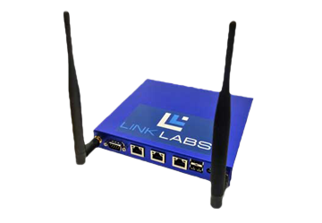
LoRa in Low-Power Wide-Area Network
RHF76-52AM module
RHF76-52AM module
RHF76-52AM module
STM32L051/052XX
STM32L051/052XX
ATSAMD21G18
Processor
STM32L051/052XX
ATSAMD21G18
Processor
ATSAMD21G18
Processor
Star topology
AT Commands
AT Commands
AT Commands
SPI
SPI
SPI
SX1276
SX1276
SX1276
SRAM, Flash, SERCOM...
SRAM, Flash, SERCOM...
SRAM, Flash, SERCOM...
Instructions
Gateways, LoRa Devices, etc..
Instructions
Instructions

Slide 15
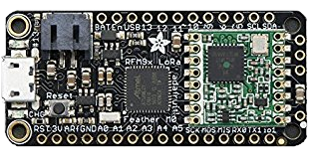
LoRa in Low-Power Wide-Area Network
Star topology
Point to Point Connection
Seeeduino LoRa
Adafruit Feather 32u4 RFM95 LoRa

Slide 16
LoRa in LPWAN : Hands-On Example
Who is there?
Me, I’m ID: 639
Nice to meet you 639 !
639, Give me value of A0 !
639, What’s your position ?
639, A0 is X volts
639, My position is [NMEA Payload]

Slide 17
LoRa in LPWAN : Hands-On Example
Slave side
Send Broadcast MSG
Master side
Idling system
Sleep 10 s
Send to Master my ID
Save every slaves
0
Rec: Master is Asking
Rec: Slave is answering
1
Wait 5 s
Wait for slaves (5 seg)
3
No response
Try 10x
Establishment time
Try 2x
Reset every 2 min
Rec: ACK with my ID
Saved all slaves
4
Time Out 1 min
2
Working system
Wait 2 min
Wait 1 min
Ask every slaves
Rec: Master wants a value
Send to Master the value

Slide 18
LoRa in LPWAN : Hands-On Example
NOW LET’S FUN BEGIN!
And remember, If it works don’t touch it …

